Slide 1
Understanding WebDriver

Slide 2
What Is WebDriver?
Chrome
Firefox
IE
HtmlUnit
WebDriver Test Script

Slide 3
Finding Elements
ClassName
ID
Name
TagName
CssSelector
LinkText
PartialLinkText
XPath

Slide 4
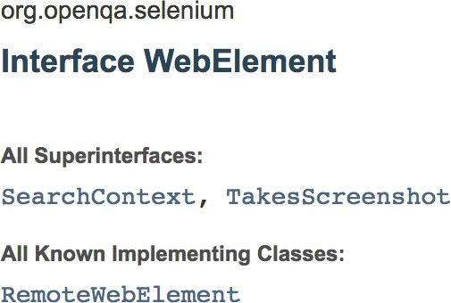
clear click findElement findElements getAttribute getCssValue sendKeys submit

Slide 5
isDisplayed isEnabled getLocation isSelected getSize getTagName getText

Slide 6

Summary
Browsers WebElement Navigate findElements() CSS Selector

